Slide 1
CSCE 5520
Wireless Networks and Protocols Signal Propagation

Slide 2
Signal Propagation
In communications, signal propagation is the movement of signals from the transmitter to the receiver through a transmission medium.
Wireless signal propagation is the movement of the radio waves (which move at the speed of light) to and from these sites and devices.
Wireless communications systems are composed of one or more “Antenna Sites”, “Tower Sites”, or “Cell Sites”.
Antennas mounted on these structures pump out wireless communications signals to devices in the field via electromagnetic waves. User devices receive these signals and transmit similar types of signals back to the sites. This creates two-way communication.

Slide 3
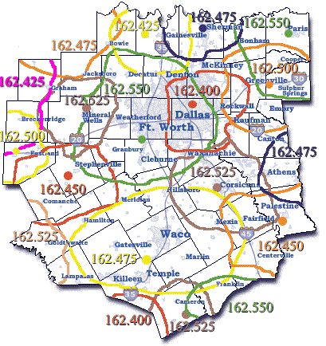
What is Coverage?
Areas where two-way communication can occur at a defined level are said to be “covered.” Areas where either inbound or outbound directions fail, or exist below a defined level, are considered “uncovered”

Slide 4
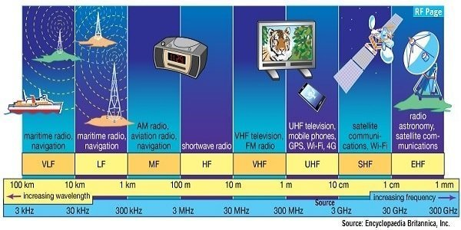
What impacts Coverage?
FREQUENCY: Typically, the lower the frequency, the farther the usable signals will go.
POWER: A doubling of power (in Watts) equates to a 3 dB boost in signal strength.
OBSTACLES: topography, Buildings, trees, etc.

Slide 5
Other considerations
•Diffraction
• How signals behave moving around obstacles
• Multipath
• How reflected signals can either help or hinder reception
•ATTENUATION, aka “Penetration Loss”
• Predicted weakening of the signals through obstacles

Slide 6
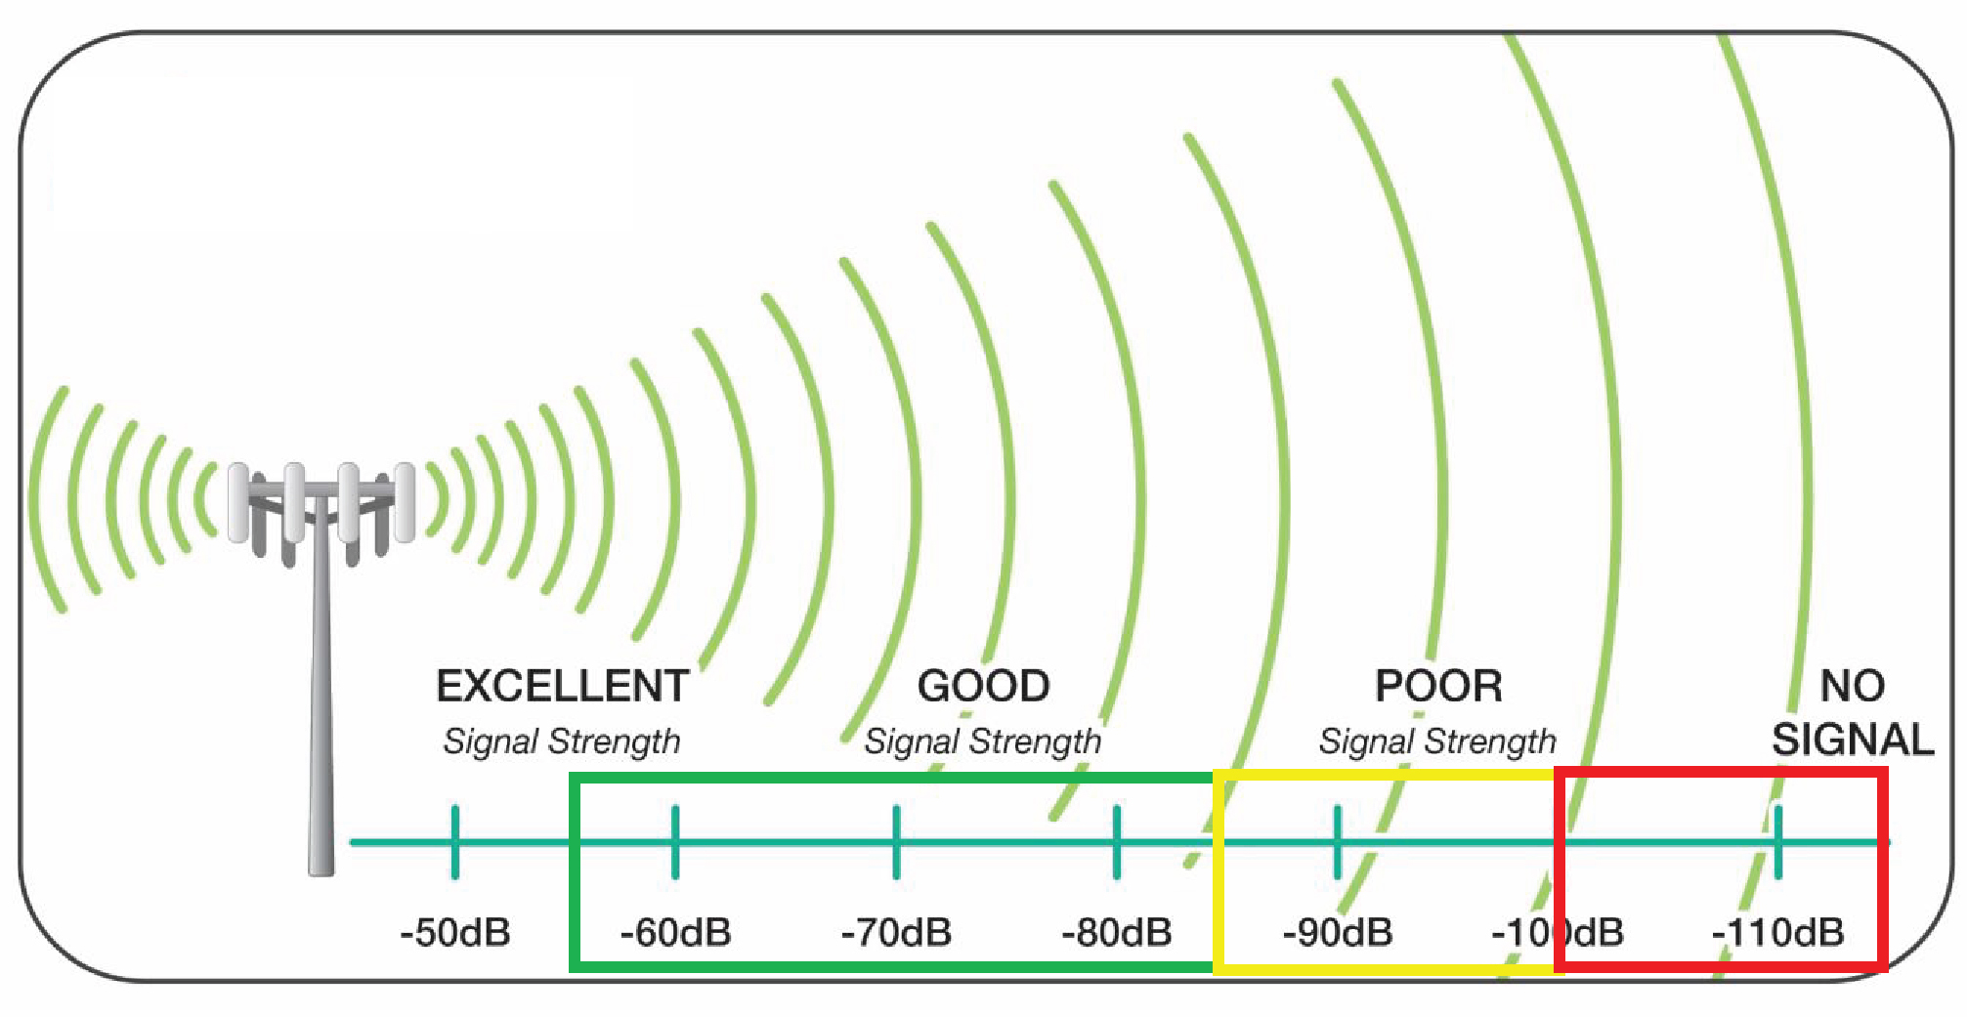
Signal Strength
The signal strength is the wireless signal power level received by the wireless client.
Strong signal strength results in more reliable connections and higher speeds.
Signal strength is represented in -dBm format (0 to -100). This is the power ratio in decibels (dB) of the measured power referenced to one milliwatt.
The closer the value is to 0, the stronger the signal. For example, -41dBm is better signal strength than -61dBm.

Slide 7
Noise
The noise level indicates the amount of background noise in your environment.
If the noise level is too high, it can result in degraded strength and performance for your wireless signal strength.
Noise level is measured in -dBm format (0 to -100). This is the power ratio in decibels (dB) of the measured power referenced to one milliwatt.
The closer the value to 0, the greater the noise level.
Negative values indicate less background noise. For example, -96dBm is a lower noise level than -20dBm.

Slide 8
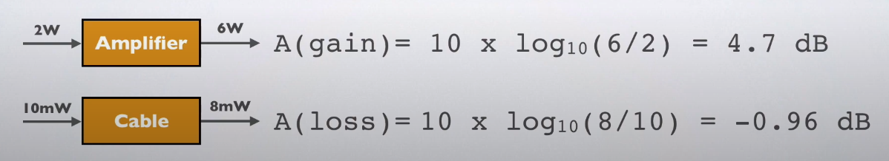
Decibel (dB)
The decibel (dB) is a unit used to express the ratio of powers of sound pressure, signal strength or other things on logarithmic scale.
The decibel is a relative unit of measurement equal to one tenth of a bel (B), invited by Bell Labs and named after Alexander Graham Bell.
Decibel = 10 * log10 (P_{o}/P_{i}) dB
_{Where} P_{o is output power and} P_{i is an input power}

Slide 9
Decibel (dB)
Note decibel is a relative value
decibel-watt (db) = power relative to 1W
Decibel-milliwatt(dBm) = power relative to 1 milliwatt
The logarithmic scale is used to is to avoid dealing with very high and very low numbers, meaning the ratio. Using decibels is easy to work with
For example:
A power of ratio of 1,000,000 (1million) can be expressed by 60dB
A power of ratio of 0.000001 can be expressed by -60dB
A power of ratio of 1,000,000,000,000,000 (1quadrillion) can be expressed by 150dB
A power of ratio of 0.000000000000000 1 can be expressed by -150dB

Slide 10
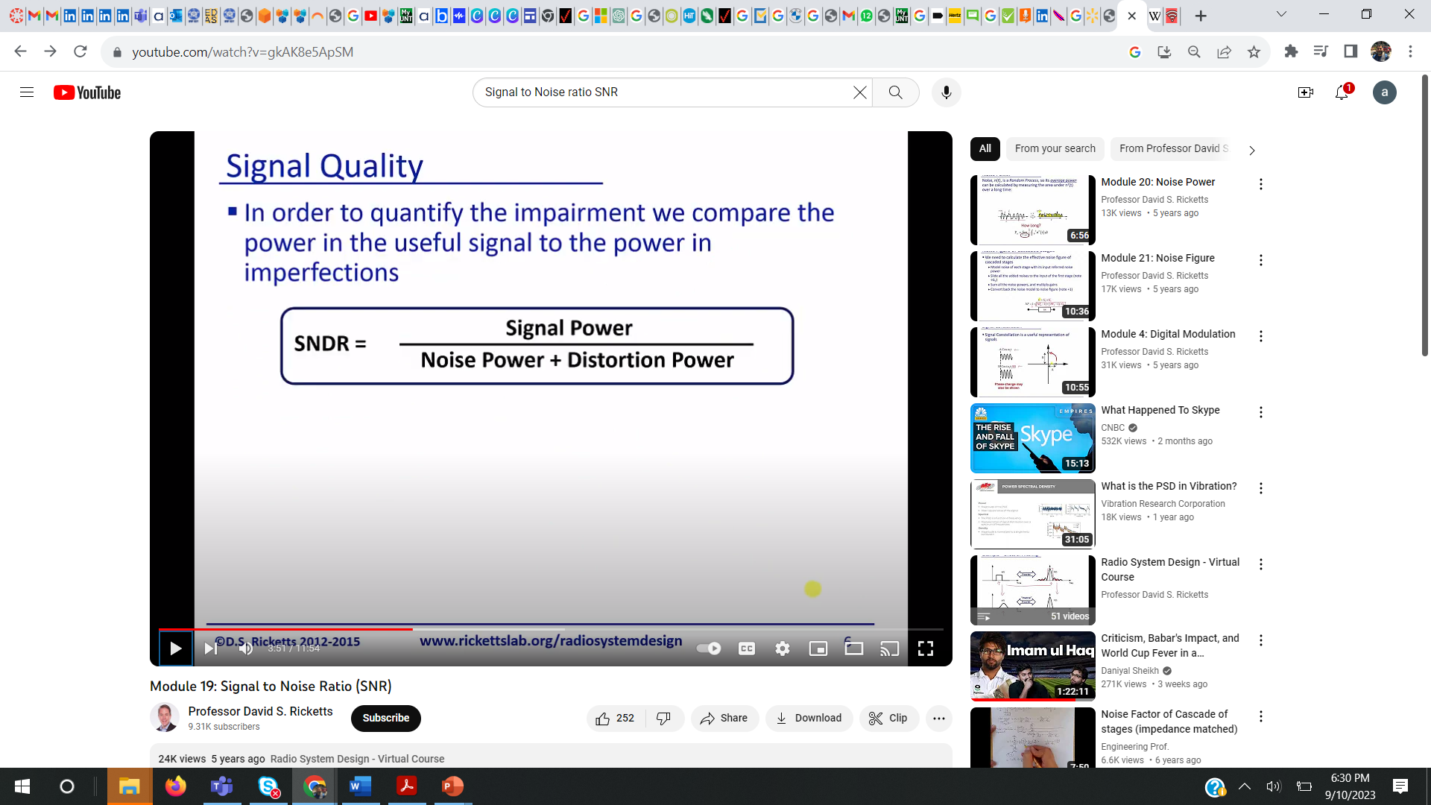
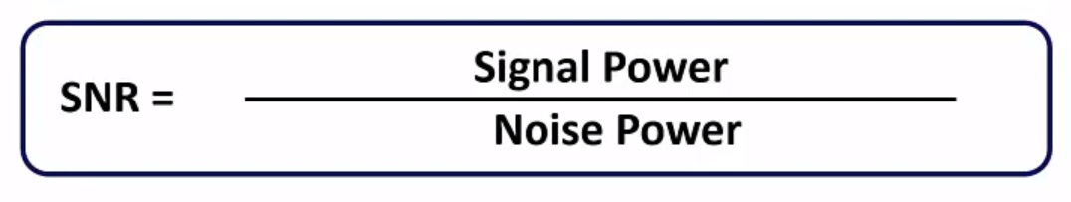
Signal Quality
In order to quantify the impairment, we compare the power of useful signal to the power of imperfections
In many cases, it is hard to distinguish random noise from distortion, so all is regarded as noise

Slide 11
Signal to Noise Ratio
The signal-to-noise ratio (SNR) is the power ratio between the signal strength and the noise level.
This value is represented in decibels (dB).
In general, you should have a minimum of +25dB signal-to-noise ratio. Lower values than +25dB result in poor performance and speeds.
For example:
If you have a -41dBm signal strength, and a -50dBm noise level, this results in a poor signal-to-noise ratio of +9dB.
If you have a -41dBm signal strength, and a -96dBm noise level, this results in an excellent signal-to-noise ratio of +55dB.

Slide 12
Shannon Theorem
Shannon’s theorem gives the capacity of the system in presence of noise:
C = B log ₂(1+SNR)
Signal-to-noise ratio (SNR, or S/N)
A high SNR means a high-quality signal
Low SNR means that it may be hard to “extract” the signal from the noise

Slide 13
The Nyquist Limit
A noiseless channel of bandwidth B can at most transmit a binary signal at a capacity 2B
» e.g., a 3000 Hz channel can transmit data at a rate of at most 6000 bits/second
» Assumes binary amplitude encoding
For M levels: C = 2B log2 M
» M discrete signal levels
More aggressive encoding can increase the actual channel bandwidth
» Example: modems
Factors such as noise can reduce the capacity

Slide 14
Example

Slide 15
Example

Slide 16
What is an Antenna?

Slide 17
Types of Antennas

Slide 18
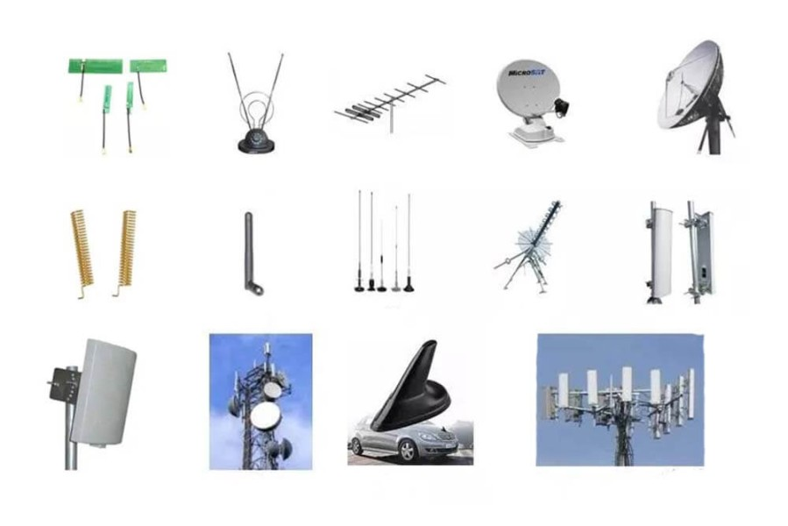
Different types of Antenna

Slide 19
Propagation modes

Slide 20
Refraction, Diffraction, Scattering

Slide 21
Refraction, Diffraction, Scattering
Besides line of sight, signal can reach receiver in three “indirect” ways.
Reflection: signal is reflected from a large object.
Diffraction: signal is scattered by the edge of a large object – “bends”.
Scattering: signal is scattered by an object that is small relative to the wavelength.

Slide 22
Channel Model
Power profile of the received signal can be obtained by convolving the power profile of the transmitted signal with the impulse response of the channel.
Signal x, after propagation through the channel H becomes y:
y(f)=H(f)x(f)+n(f)
Here H(f) is channel response, and n(f) is the noise. Note that x, y, H, and n are all functions of the signal frequency f

Slide 23
Path Loss model
Path Loss Models are commonly used to estimate link budgets, cell sizes and shapes, capacity, handoff criteria etc.
“Macroscopic” or “large scale” variation of RSS
Path loss = loss in signal strength as a function of distance
Terrain dependent (urban, rural, mountainous), ground reflection, diffraction, etc.
Site dependent (antenna heights for example)
Frequency dependent
Line of sight or not
Simple characterization: PL = L₀ + 10α log10(d)
L₀ is termed the frequency dependent component
The parameter α is called the “path loss gradient” or exponent
The value of α determines how quickly the RSS falls with distance

Slide 24
The Free Space Loss
Assumption
Transmitter and receiver are in free space
No obstructing objects in between
The earth is at an infinite distance!
The transmitted power is P_{t}
The received power is P_{r}
The path loss is L_{p} = P_{t} (dB) – P_{r} (dB)
Isotropic antennas
Antennas radiate and receive equally in all directions with unit gain

Slide 25
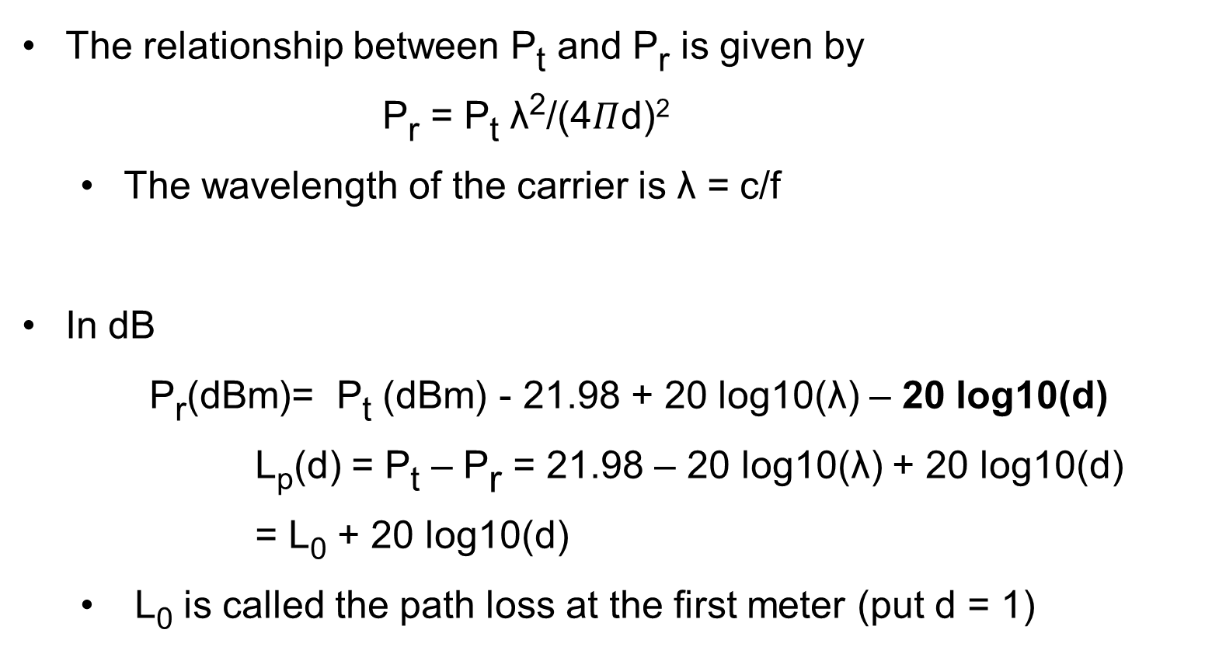
The Free Space Loss
The relationship between P_{t} and P_{r} is given by
P_{r} = P_{t} λ²/(4$Π$d)²
The wavelength of the carrier is λ = c/f
In dB
P_{r}(dBm)= P_{t} (dBm) - 21.98 + 20 log10(λ) – 20 log10(d)
L_{p}(d) = P_{t} – P_{r} = 21.98 – 20 log10(λ) + 20 log10(d)
= L₀ + 20 log10(d)
L₀ is called the path loss at the first meter (put d = 1)

Slide 26
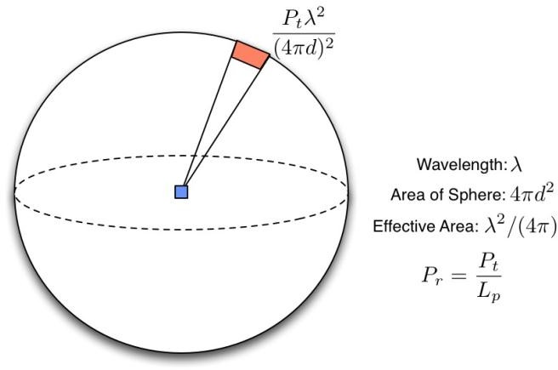
A simple explanation of free space loss
Isotropic transmit antenna: Radiates signal equally in all directions
Assume a point source
At a distance d from the transmitter, the area of the sphere enclosing the Tx is: A = 4πd²
The “power density” on this sphere is: P_{t} / 4πd²
Isotropic receive antenna: Captures power equal to the density times the area of the antenna
Ideal area of antenna is
A_{ant} = λ²/4π
The received power is:
P_{r} = P_{t} / 4πd2 x λ²/4π = Pt λ²/(4πd)²

Slide 27
Isotropic and Real Antennas
7
Isotropic antennas are “ideal” and cannot be achieved in practice
Useful as a theoretical benchmark
Real antennas have gains in different directions
Suppose the gain of the transmit antenna in the direction of interest is G_{t} and that of the receive antenna is G_{r}
The free space relation is:
P_{r} = P_{t} G_{t} G_{r} λ²/(4πd)²
The quantity P_{t} G_{t} is called the effective isotropic radiated power (EIRP)
This is the transmit power that a transmitter should use were it having an isotropic antenna

Slide 28
Summary: Free space loss
Transmit power P_{t} and received power P_{r}
Wavelength of the RF carrier λ = c/f
Over a distance d the relationship between P_{t} and P_{r} is given by:
_{Pr =} t
Pλ²
(4π )² d ²
where d is in meters
In dB, we have:
P_{r} (dBm)= P_{t} (dBm) - 21.98 + 20 log₁₀ (λ) – 20 log₁₀ (d) Path Loss = L_{p} = P_{t} – P_{r} = 21.98 - 20log₁₀(λ) + 20log₁₀ (d)

Slide 29
Example
Consider Design of a Point-to- Point link connecting LANs in separate buildings across a freeway
Distance .25 mile
Line of Sight (LOS) communication
Spectrum Unlicensed – using 802.11b at 2.4GHz
Maximum transmit power of 802.11
AP is Pt = 24dBm
The minimum received signal strength (RSS) for 11 Mbps operation is -80 dBm
Will the signal strength be
adequate for communication?
Given LOS is available can
approximate propagation
with Free Space Model as
follows

Slide 30
Example (cont.)
Example :
Distance .25 mile ~ 400m
Receiver Sensitivity Threshold = - 80dBm
The Received Power P_{r} is given by P_{r} = P_{t} - Path Loss
P_{r} = P_{t} - 21.98 + 20 log₁₀ (λ) – 20 log₁₀ (d)
= 24 – 21.98 + 20log₁₀ (3x10⁸/2.4x10⁹) – 20 log₁₀ (400)
= 24 -21.98 -18.06 -52.04
= 24 – 92.08 = -68.08 dBm
P_{r} is well above the required -80 dBm for communication at the maximum data rate – so link should work fine
L₀ = 40 dB
at 2.4 GHz
30

Slide 31
Cell/Radio Footprint
The Cell is the area covered by a single transmitter
Path loss model roughly determines the size of cell
31

Slide 32
General Formulation of Path Loss
Depending on the environment, it is seen that the path loss
(or the RSS) varies as some power of the distance from
the transmitter d
Here α is called the path-loss exponent or the path-loss
gradient or the distance-power gradient
The quantity L₀ is a constant that is computed at a reference distance d₀
This reference distance is 1m in indoor areas and 100m or 1 km in outdoor areas

Slide 33
More Comments
Path loss is a function of a variety of parameters
Terrain
Frequency of operation
Antenna heights
Extremely site specific
Varies depending on environment
Example: indoor Vs outdoor
Example: microcell Vs microcell
Example: rural Vs dense urban
Large number of measurement results are available for different scenarios, frequencies and sites
Empirical models are popular
18

Slide 34
Obstacles and Atmosphere
Objects absorb energy as the signal passes
through them
Degree of absorption depends strongly the material
Paper versus brick versus metal
Absorption of energy in the atmosphere.
Very serious at specific frequencies, e.g., water vapor (22 GHz) and oxygen (60 GHz)
Refraction in the atmosphere
Pockets of air can have different properties, e.g., humidity, temperature, …
Redirects the signal in unpredictable ways
Can reduce energy and increase path length

Slide 35
Multipath Effect

Slide 36
Fading in Mobile Environments

Slide 37
Inter-Symbol Interference

Slide 38
Doppler Effect

Slide 39
Summary

